Slide 1

CharacterSmith3.5e
Alex Madarese, Jefferson Boyd, Nathan Fitzpatrick

Slide 2
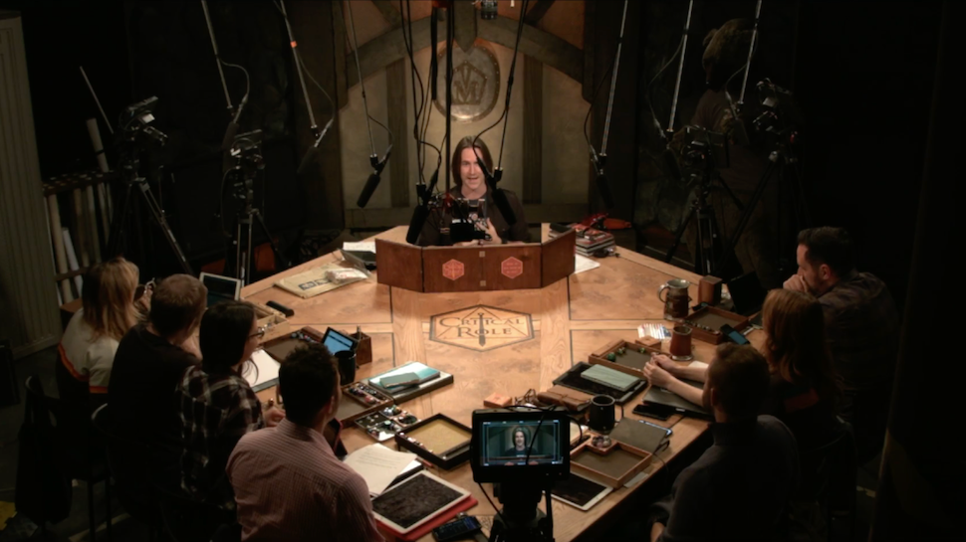
Quick Recap
D&D 3.5e Character Creator
Downloadable Java Application
Add functionalities to assist DMs with quickly creating NPCs
Notes:
So to recap, we wanted to make a tool that partially automates the character creation process for D&D 3.5e
To do this, we’ve made a downloadable Application using Java that allows you to pick options and output them once the character is finished
And we plan to add features that allow DMs to create NPCs quickly by selecting the key character traits they want and having the tool generate the rest.

Slide 3
System Overview
Use D&D3.5e character creation to model the system
Consists of a user interface allowing interaction between the user and the application
Functions locally and offline
Notes:
Since our character creator is for making D&D3.5e characters, we used that game’s character creation rules as guidelines for this system
So we followed their methods for calculating certain numbers and any restrictions they had in the character creation process
The system consists of a user interface allowing the user to view and make changes to their character in the application
And finally, this app was designed to be used locally without needing internet access, beyond the initial download

Slide 4
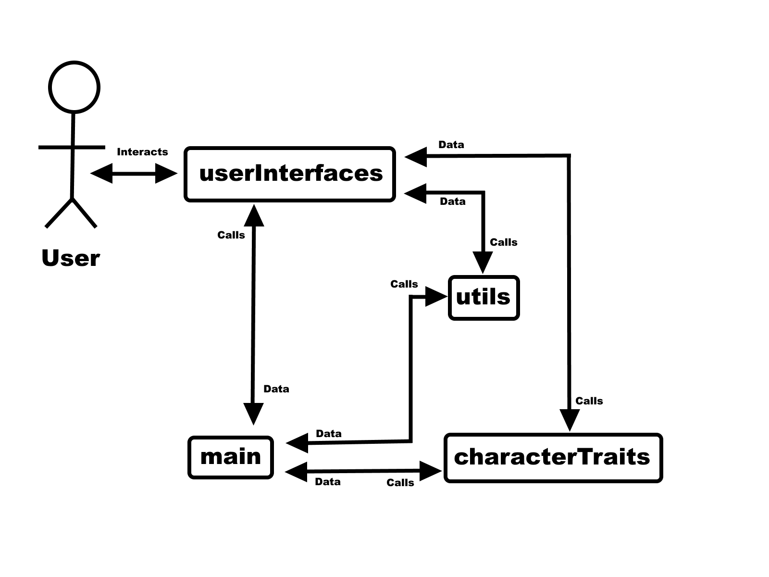
System Components & Actors
Four types of components (packages):
User Interfaces
Utils
The main package
Character Traits
Only one type of Actor:
User
Notes:
There is only one type of actor–that being the user– but the user could potentially be either a player making their character, a DM making NPCs, or a DM/experienced player advising a player how to make their character.
So while there’s only one role here, there’s different extensions of that role

Slide 5
Architectural Style
Layered
User -> GUI -> Backend Components
Justification
Simplicity
GUI relies on backend layers for calculations/functionality
Assists in increasing legibility for first time user

Slide 6
Design Patterns
Chosen design patterns:
Factory method
Created multiple similar classes with the same interfaces
Used objects in order to store instances of data
Façade method
Presented with a simple and straightforward interface
Contained several complex subsystems within the software

Slide 7

Framework
Java Swing Application Framework
Simple to use
Libraries are included in base java installations
Allows entire application to be coded in and run using java

Slide 8
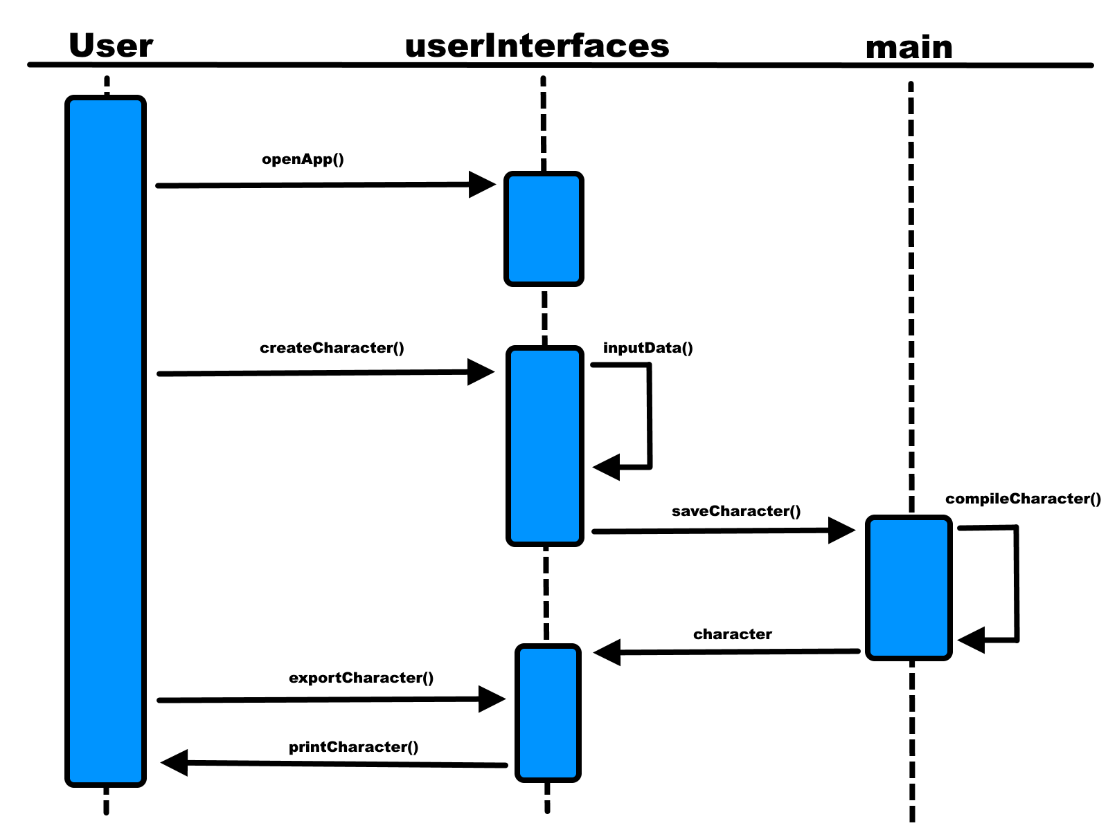
Sequence Diagram

Slide 9
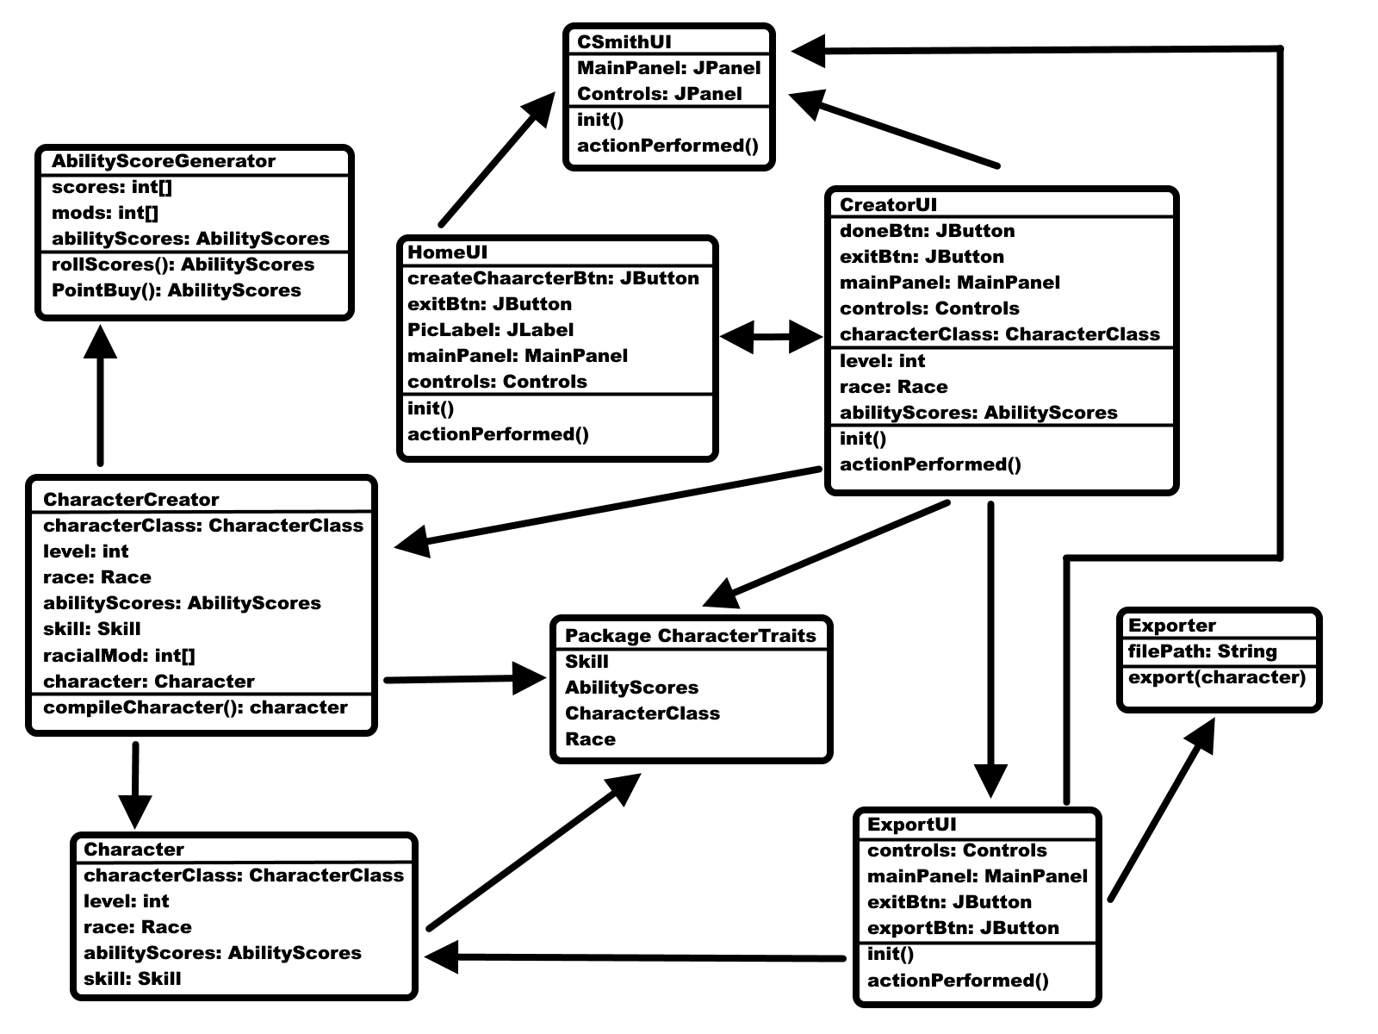
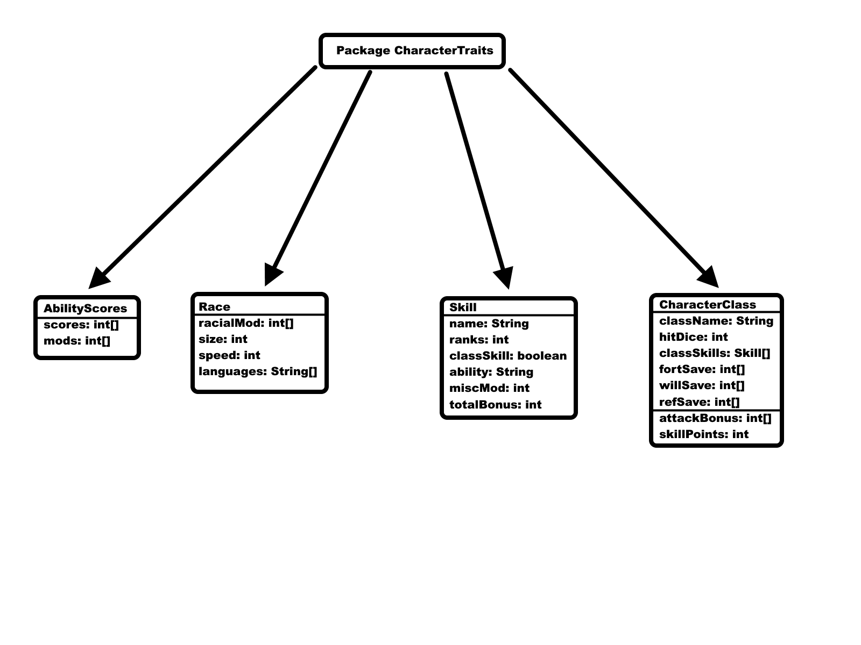
Class Diagram
Notes:
User clicks to go from Home UI to character UI
Take input from user
And put in character creator
Does calculations
Stored in character object
When user is done UI calls character object and shows final product
Export prints everything to an output file
Also note that the right diagram shows 4 classes that act similarly, as databases

Slide 10
Project Prototype

Slide 11
Github Link
https://github.com/jsb288/CSC431-Project.git

